Slide 1

Ahsanullah University Of Science And Technology Department Of Computer Science And Engineering
Welcome to our presentation

Slide 2


Project Name

Slide 3

Group Members
Name: Soumik Das
ID: 11.02.04.003
Name: Naimul Mukit
ID: 11.02.04.009
Name:Arefin Naveed
ID: 11.02.04.002
Semester: 2.1
Section: A
Section group: A1
Supervised by:
AFSANA AHMED
SANJIDA KHATUN

Slide 4

Introduction
DX-ball is a 2D game . It is a game on pc.
Such kind of games like DX-ball are played for having fun and as a part of recreation.
It can be played when we are free and pass our leisure time.
It is very easy to play. Just only mouse and sometimes keyboards are needed to play it.

Slide 5

Game History
DX-Ball is a freeware computer game for the PC first released in 1996 by Michael P. Welch.
It became a massive cult classic in the Windows freeware gaming community during the late 1990s.
A level editor was made available as well.
DX-Ball has been followed up by two direct sequels: DX-Ball 2 by Longbow Digital Arts in 1998, and Super DX-Ball by Michael P. Welch himself in 2004.

Slide 6

How to Play DX-Ball
The game is basically a Breakout clone: you bounce a ball off a paddle at the bottom hitting the bricks on the top of the screen. Hitting all the bricks results in completing the level and going to the next. There are 2 levels to complete. Unlike Breakout, however, is the inclusion of power ups other than extra balls.
If you fail to catch the ball then it will go below and will result in Game over.
Score Increases by hitting the Bricks. And when All the bricks are hit then you mastered the game.
Game differs by Changing of levels. In fact it becomes harder by increasing levels.
In this way you have to play this interesting game.

Slide 7

Components used in developing game
Eclipse compiler
NetBeans 7.0.1 compiler
Java Language(Object Oriented programming,GUI)
Necessary Game Images

Slide 8

Description of the Components
Eclipse compiler: Eclipse compiler is a good compiler to develop java games .That’s why it is being used.
NetBeans 7.0.1 compiler: It is good for java desktop applications. It was used to take valuable helps.
Java Language: Object Oriented principles(Constructors , Inheritence,Interface),Graphical User Interface (Jtextfield,Jframe,Jpanel,JButton) was used to develop this game. Images and Audio clip was also used further.
Game Images: Necessary Images of the Game was being Downloaded or collected from different sources.

Slide 9


Compiler
Eclipse is a multi-language software development environment comprising a workplace and an extensible plug-in system. It is written mostly in Java.
It can be used to develop applications in Java and, by means of various plug-ins, other programming languages including Ada, C, C++, COBOL, Fortran, Haskell, Perl, PHP, Python, R, Ruby (including Ruby on Rails framework), Scala, Clojure, Groovy, and Scheme. It can also be used to develop packages for the software Mathematica.
Development environments include the Eclipse Java development tools (JDT) for Java and Scala, Eclipse CDT for C/C++ and Eclipse PDT for PHP, among others.

Slide 10
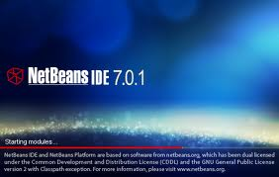

Compiler
Netbeans is an integrated development environment (IDE) for developing primarily with Java, but also with other languages, in particular PHP, C/C++, and HTML5. It is also an application platform framework for Java desktop applications and others.
NetBeans IDE 6.0 introduced support for developing IDE modules and rich client applications based on the NetBeans platform, a Java Swing GUI builder (formerly known as "Project Matisse"), improved CVS support, WebLogic 9 and JBoss 4 support, and many editor enhancements.
NetBeans 6 is available in official repositories of major Linux distributions.

Slide 11


Java
There were five primary goals in the creation of the Java language:^{[23]}
It should be "simple, object-oriented and familiar"
It should be "robust and secure"
It should be "architecture-neutral and portable"
It should execute with "high performance"
It should be "interpreted, threaded, and dynamic"
Versions
Main article: Java version history
Major release versions of Java, along with their release dates:
JDK 1.0 (January 21, 1996)
JDK 1.1 (February 19, 1997)
J2SE 1.2 (December 8, 1998)
J2SE 1.3 (May 8, 2000)
J2SE 1.4 (February 6, 2002)

Slide 12

Object oriented programming
Object-oriented programming (OOP) is a programming paradigm that represents concepts as "objects" that have data fields (attributes that describe the object) and associated procedures known as methods.
Objects, which are instances of classes, are used to interact with one another to design applications and computer programs.

Slide 13
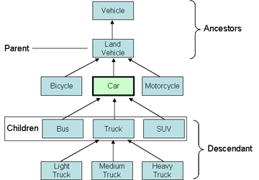
Example of Object Oriented principle

Slide 14
Game Features
NEW GAME
LOAD GAME
SAVE GAME
SETTINGS
ABOUT
HELP
EXIT

Slide 15
New game: * Single player Load game: Start a previously saved game Settings: *sound: sets the sound off or on *music: a music that will be being played through the whole time On/off *sfx: sound of Brick hitting and Ball throwing etc. On/off Help: *instructions: how to play the game *Levels: details about the levels after levels *History: The story on which the game is based on About: Info about the game developer Exit: Exit the game window

Slide 16
Game Objects
1.Bar: A rectangle shaped bar will be at the bottom of the game window with a constant colour.
Bar Size: Small and constant.
Bar movement: Bar will move by pressing the keyboard movement (left sticks). And that will move from left to the right.
Number of bar: one
2. Bricks: The bricks will be placed in a particular position. They will be rectangle in size. There number will be more than 10 or more. Size: Small/medium
Colour: Yellow, Red, green
Movement: Boxes won’t move.
3. Ball: A ball with a circle shape will be always moving when it touches the bar.
Size: Small Hitpoints: same for all boxes
Colour: Same for all levels .
4. Screen: Screen colour will change by the change of levels.
Size: Large
5. Levels: 2 levels

Slide 17
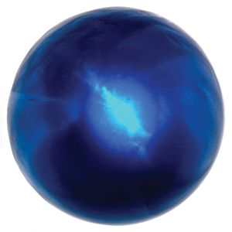


Game Images
Bar:
Ball:
Brick:
Background:

Slide 18



Game Images
Life_Plus:
Game_over_image:
Bar_size_increase:
Bar_size_decrease:
Ball_On_hury:

Slide 19
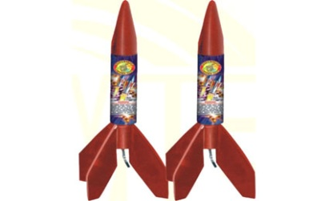

Game Images
Rockets :
Bullets :

Slide 20

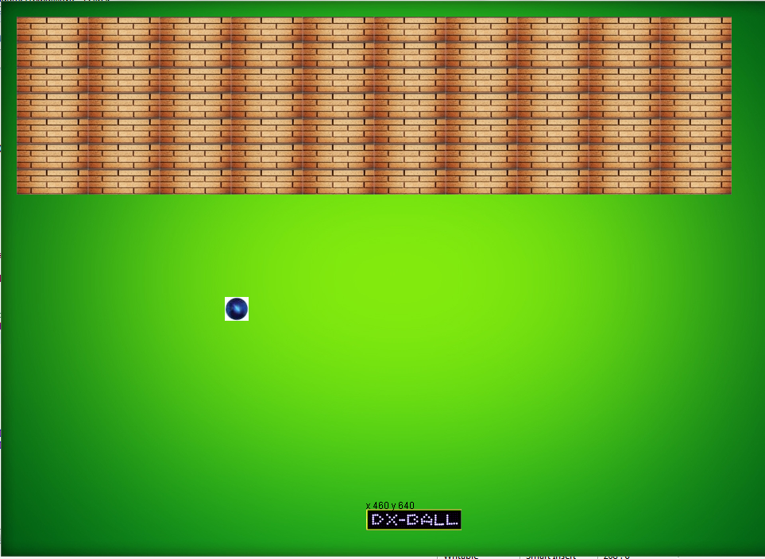
Game Screenshot

Slide 21
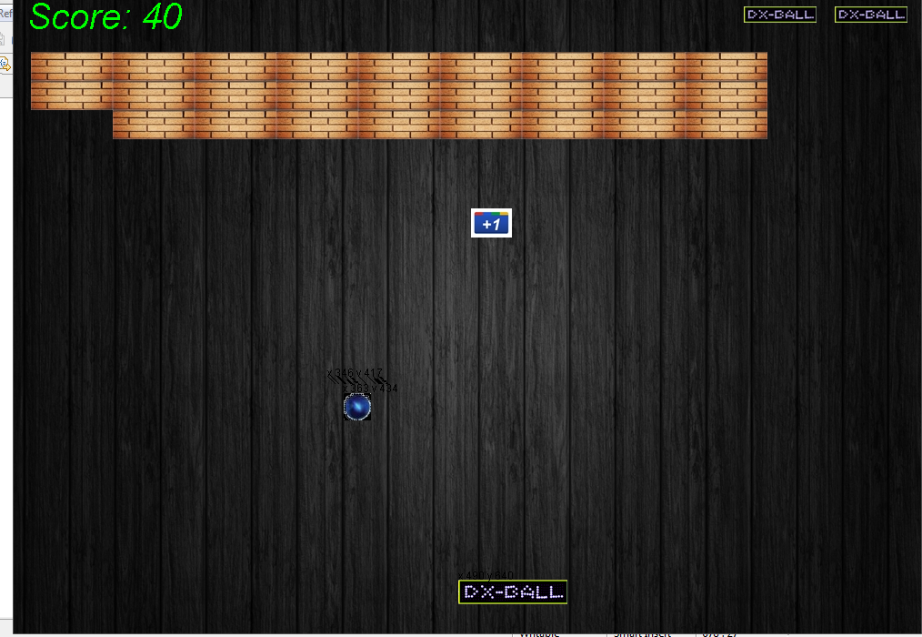
Game Screenshot

Slide 22
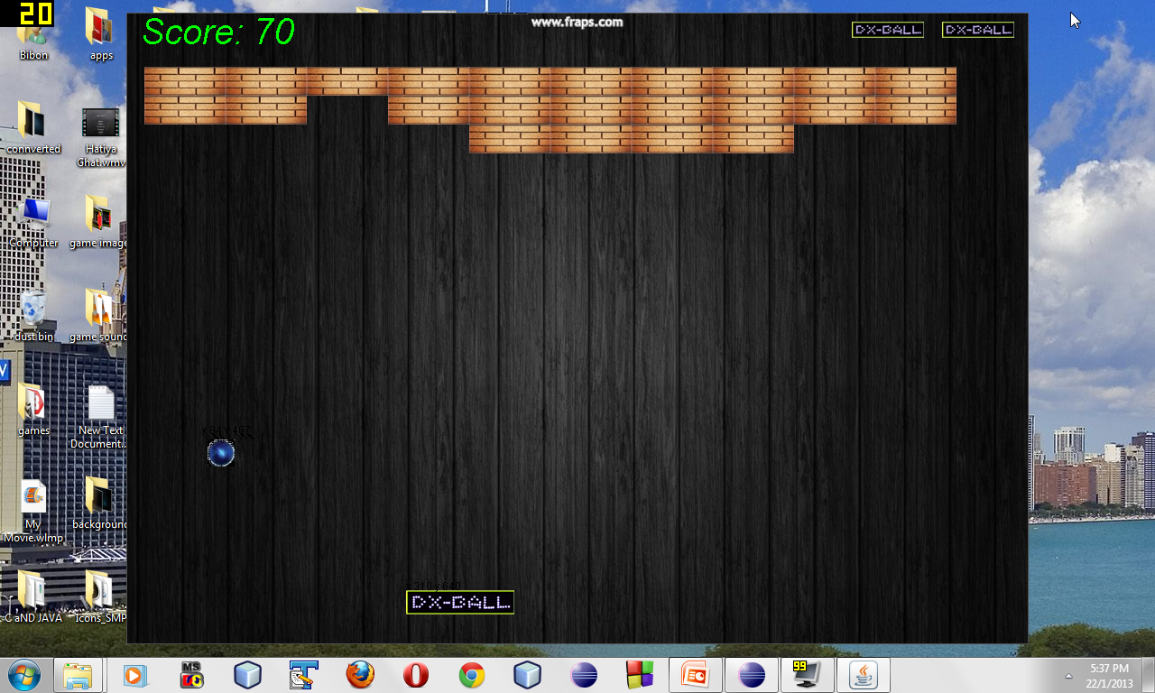
Game Screenshot Video

Slide 23

Game Levels
Level 1
Objective: Hitting all the Boxes in the window Location: Green Screen.
Description:
A constant sized ball will be moving and when it comes down it will touch the bar and will return to the top. If the player fails to touch the ball through bar then the ball will fall down , and the game will over. Player will have to hit each and every boxes shown in the window to pass Level 1.

Slide 24
Game Levels
Level 2
Objective: Hitting more Boxes than Level 1 within a particular time Location: Black Screen. Description:
In this Level Player will have to hit more boxes than level 1. That means the number of Boxes will increase. And there will be a particular time period. In this time period the player will have to finish his game. Otherwise the game will be Over. The rules of Level 2 will be as same as in Level 1.

Slide 25
What we couldn’t do
In our game we couldn’t call the main method , by which our game starts… from the actionperformed() method .
We placed the Thread.sleep() method in the ballmove function and it is in the While loop. So each and every time it is being called.
And the it freezes. So when we call it it doesn’t work.
We also couldn’t give mainmenu for this same reason.
This problem is called the The GUI freeze problem.

Slide 26

Conclusion
DX-Ball is an interesting game.
It is one of the smallest games in pc.
People of every ages can play it and have fun.
Specially the children have fun playing it.
In fact DX-ball is a good game for all.

Slide 27


